Slide 1
GREEN ICT & CONVERGENCE
Werner Kapp
30/07/2009

Slide 2
AGENDA
What is the problem?
What is Green ICT?
What is convergence?
What does this have to do with us?
  Business challenge
  Technology answers
  Case studies
What is your organisation’s Green ICT strategy?
Summary

Slide 3
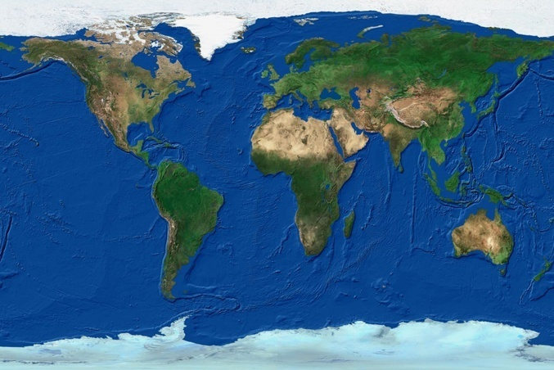
What is the problem?
60
50
?
35 Gt CO2e
40
Global Emissions
(Gt CO2e)
30
20
10
1990
2000
2020
2040
2060
Source: Stern Review – The Economics of Climate Change

Slide 4
What is the problem?
“9. Sustainable resource management and use: Like the rest of the world, we are vulnerable to the impacts of climate change, biodiversity loss and diminishing water resources. Interventions will include, amongst others, diversification of the energy mix in pursuit of renewable energy alternatives and the promotion of energy efficiency, enforcing a zero tolerance approach to illegal and unsustainable exploitation of resources, supporting local and sustainable food production, and promoting sustainable water use and preserving the quality of drinking water.”
  - Notes for background briefing on the Medium Term Strategic Framework (MTSF), 2009 to 2014 by Mr T Manuel, Minister in The Presidency: National Planning (14 July 2009)

Slide 5

What is GREEN ICT?
Notes:
Green ICT is the study and practice of using computing resources efficiently. The primary objective of such a program is to account for the triple bottom line, an expanded spectrum of values and criteria for measuring organizational (and societal) success.
ICT industry accounts for 2% of world’s global CO2 emmisions.

Slide 6















What is CONVERGENCE?
S E R V I C E S
Telephony
Signage
Access
Fire
HVAC
Lighting
Wireless
Internet
Information
Systems
Conferencing
Surveillance
Energy
Lifts
Planet

Slide 7
What does this have to do with us?
CIO job description: Fix BUSINESS CHALLENGES with TECHNOLOGY
=
=
How do we
reduce our use
of non-renewable
resources?
Using
convergence?

Slide 8
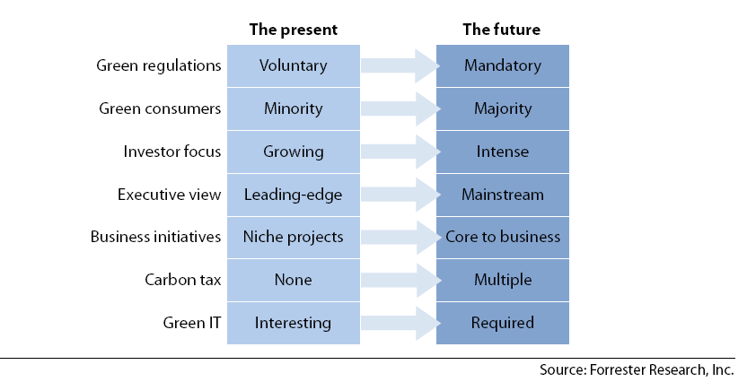
Business challenge

Slide 9
Business challenge
Energy unavailable
or unreliable
Cost savings
Carbon footprint
and reputation

Slide 10
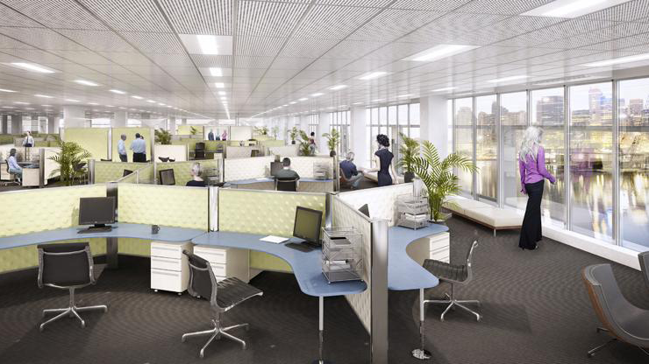
Technology answer: Green buildings
Light level meters,
daylight harvesting
Occupancy
sensors
Access Control
Dynamic chilling/heating,
maximized fresh air
IP CCTV
Tele/video
conference
White Noise
Level Adjustments
Wireless
Operable windows
for natural ventilation
Power
monitoring
10

Slide 11
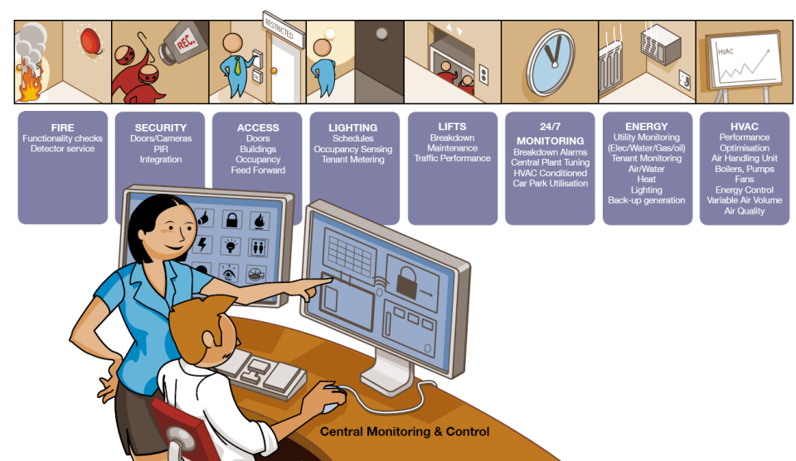
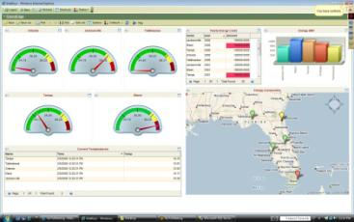
Technology answer: Converged Real Estate

Slide 12
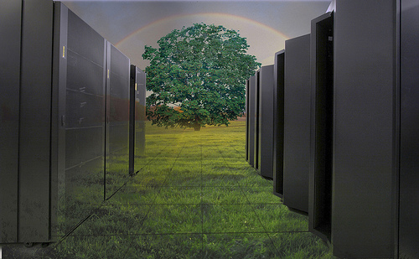
Technology answer: Green data centres

Slide 13
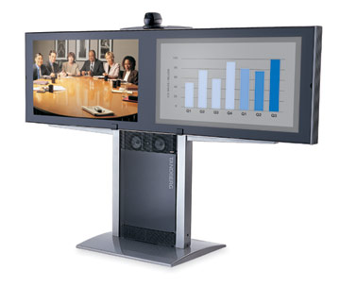
Technology answer: Video-conferencing

Slide 14
Case studies
Green Data Centre: Dimension Data North America
Video-conferencing: Mazda Australia
Converged Real Estate: Nelson Mandela Multi-Purpose Stadium

Slide 15

What is your org’s Green ICT strategy?
LICENCE TO OPERATE
Employee Engagement
GO-TO-MARKET
Licence To Operate – Getting our house in order
Employee Engagement – Responsible environmental stewardship
Go To Market – Carbon Friendly Infrastructure
SOURCE: Dimension Data’s Green ICT Strategy (2008)

Slide 16
What is your org’s Green ICT strategy?
Licence To Operate
Employee Engagement
Go-To-Market
Green Grid Membership
Carbon Disclosure Project (CDP)
Responding to the CDP in 2009
Rolling out pilot of our Environmental Management System (EMS) in Australia, South Africa and United Kingdom
EMS to be based on ISO 14001 framework
Launched Zerofootprint campaign in Africa on 13 October
Participated in two Green IT Conferences in SA and showcased our Green ICT solutions and services
DDU micro byte e-learning modules
Global Green Photo Competition launched in 2009
Collaboration – to tackle staff travel
Energy Efficiency – to reduce electricity consumption
Remote Access – to allow staff more flexibility and secure means to communicate and access corporate resources regardless of location
Virtualisation – to address IT infrastructure’s contribution to green house emissions, etc

Slide 17
Summary
Understand the business challenge;
Articulate ICT strategies to help achieve them:
  Direct (e.g. Carbon Friendly ICT infrastructure)
  Indirect (e.g. Green buildings; converged real estate)
  Enabling (e.g. Video-conferencing)
Implement;
Measure;
Feedback;

Slide 18

QUESTIONS?
18
dimensiondata.com

